Slide 1
Ireland Country Case Study
Jason Shaw EDTC 645
Tamara Blesh, Professor

Slide 2
WHAT CAN WE LEARN FROM IRELAND?
Flags retrieved from http://www.mapsofworld.com/flags/

Slide 3
While there are many similarities in the two countries education systems, we can learn from successes of Ireland.
An example of prepping students for the modern world

Slide 4
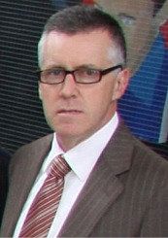
Interview with Paul Fiorentini Principal at Carndonagh Community School

Slide 5
Interview with Paul Fiorentini Principal at Carndonagh Community School
1. How important is technology integration in public schools in Ireland?
It really depends on the school, though there has been a drive nationally with the creation of a dedicated unit for advancing technology - - NCTE ; Teachers have been encouraged to incorporate ICT into Teaching and Learning. Our Dept. of Education & Skills have provided a round of grants for schools to invest in ICT - Lap-tops for teachers, servers for educational and admin use.
2. What is the biggest challenge with implementing technology in schools in Ireland?
Several challenges- though main challenge is to incorporate ICT seamlessly into the curriculum. Pupils tend to be a few chapters ahead of the majority of teachers and this requires the “retrofit" model of teacher upskilling. Cost is also a major issue.

Slide 6
Interview with Paul Fiorentini Principal at Carndonagh Community School
3. What piece of technology do you view to be most important for education?
Hitherto the lap-top and data-projector with internet access but more recently the apple iPad which we have introduced for First Years seems to offer great potential.
4. How are global perspectives integrated into the curriculum of Ireland?
We promote a world view through the general curriculum - History , Geography, etc but more focused through Social Personal and Health Education ( SPHE ) and Civic, Social and Political Education ( CSPE ) and Religious Education (RE) which is all religions and none.
5. Are there technology standards for students and teachers in Ireland? (similar to NETS)
Technology exists as a subject and is well governed by the T4 section of NCTE. It sets standards. Similarly there is a curriculum subject Technical Graphics which evolves into Design & Communications Graphics - both of which are computer based.

Slide 7
Interview with Paul Fiorentini Principal at Carndonagh Community School
6. How is the professional development of teachers in the area of educational technology or technology integration addressed?
Inconsistent and generally left to schools to determine their own needs and provide accordingly.
7. Are teachers in Ireland well versed in the technology available to them?
I can only speak for our own school where we have kept pace with developments and constantly tried to resource and upskill the teachers.
8. How does the general population feel about technology integration in the school system?
General public want ICT in schools to meet world needs and equip for job market. Not so keen on cost of continuous change and upgrade in ICT.
9. Is funding for educational technology readily available?
No, tends to be sporadic and with current state of economy likely to be even more so.

Slide 8
Insights and possible follow up questions.
It seems that he deals with the same issues that are happening in the United States. Here are some questions I would like to ask him in response.
What is your view on education in United States and technology in particular?
With funding for technology hard to come by, how does your school manage to have IWBs, iPads and other tech equipment?
How does your school keep students safe with internet use?

Slide 9
Paul Fiorentini Principal at Carndonagh Community School
Click below to read an article about the Carndonagh Community School
iPads in Ireland School
“There is an ongoing problem with school books; the increased cost, the weight of them and the fact that they are perpetually changing. It is very frustrating for everyone involved – parents, teachers and students.”

Slide 10
An example of success with ICT in Ireland. Watch this video of students during MATH WEEK.

Slide 11
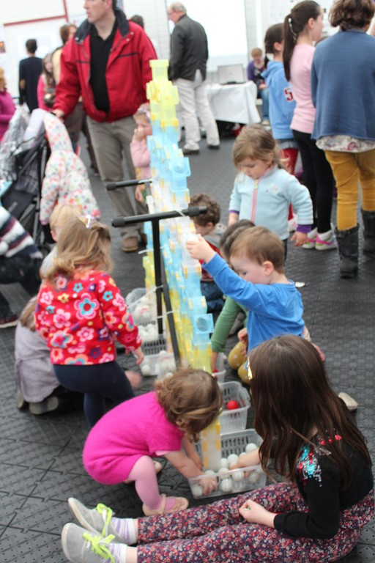
With the use of technology, these students have a new outlook on Math in Ireland.

Slide 12
This a great example of higher education in Ireland. Ireland's Institutes of Technology are flexible and dynamic university-level Institutes focused on teaching/learning, purpose-driven research, and public service.

Slide 13
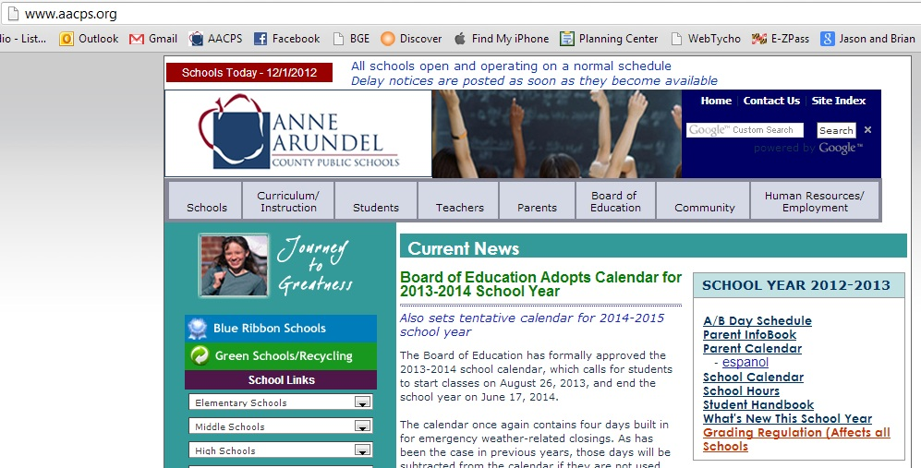
While Ireland shows promise with ICT integration in the classrooms, I feel they need to use a policy similar to my district in Anne Arundel County, Maryland.

Slide 14
Continuity across the board
Anne Arundel County and all other counties across the State of Maryland follow the same set of standards for technology.
The Maryland Teacher Technology Standards provides teachers with what is expected of them along with performance tasks.
As Paul Fiorentini states, there is little direction from the top and most of the expectations come from local administration at the schools. While this may work, if you have an excellent administrator, it still makes it difficult for teachers as their resources are limited.
Nationally, teachers also follow the NETS standards as well.
The entire county gets the same products such as Smartboards or the same textbooks which allows the support to be streamlined for all 90 schools in A.A. County.

Slide 15
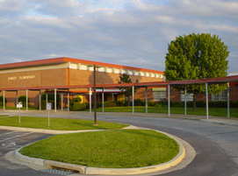
A typical classroom at Sunset Elementary School
I teach at Sunset Elementary School in Pasadena, MD. The school thrives on technology and every teacher integrates many tools daily in their lesson planning.
Here is a tour of a classroom in Sunset.

Slide 16
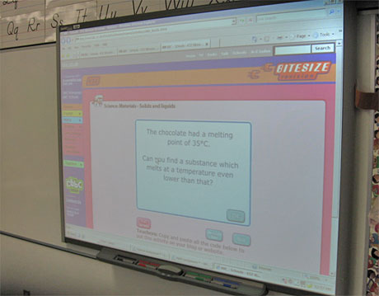
SmartBoards by Smart technologies
All classrooms in the school including cultural arts are equipped with a mounted SmartBoard with a mounted projector. All classrooms have at least one computer or laptop with Smart software installed.

Slide 17
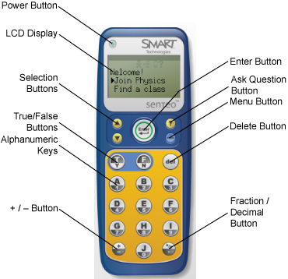
SmartBoards by Smart technologies
All classrooms also have a complete set of Sentio Smart Response remotes. Students can take quizzes or provide answers wirelessly through the remotes.

Slide 18
New this year!
The school now has 5 iPad carts loaded with one MacBook Pro and 30 iPads in each cart. The iPads provide instant excitement and motivation with the students.

Slide 19
Professional Development
Anne Arundel County offers many opportunities for teachers to learn more about technology and receive the proper training.
Webinars are offered regularly through our Blackboard site.
MSDE credited classes are provided after school, on weekends and during the summer time.
Teachers like myself are required to receive a Masters degree which can be taken in a technology field like from UMUC.
The school provides monthly professional development days where students go home 2 hours early for teachers to receive new professional development.

Slide 20
2 countries related
While the United States is a much larger country, Ireland shares similar successes and similar issues. Both countries need to continue to fight to use funding to keep up with technology and need to prepare students to become 21st century learners.

Slide 21
Resources
Images and videos retrieved from:
MTTS – http://www.mttsonline.org/
AACPS – http://www.aacps.org
Institutes of Technology - http://www.ioti.ie/
MATH WEEK Ireland - http://www.mathsweek.ie/
Paul Foirentini - http://www.inishowennews.com/images/2009/Polictians/PaulFiorentini.jpg
Carndonagh Community School - http://www.movilleinishowen.com/history/moville_heritage/jpegs/carndonagh/carndonagh_cs_logo.jpg
Belfast Model School for girls - https://www.youtube.com/watch?v=oTWOxrnnTRU
Flags retrieved from http://www.mapsofworld.com/flags/
Smartboard - https://wiki.elon.edu/download/attachments/22119808/smartboard.jpg?version=1&modificationDate=1313072253000
Sentios - http://onlinehelp.smarttech.com/english/mac/help/response/2_0_0/Clicker_with_Buttons_3.png
iPads - http://goodpasture.org/sites/goodpasture.org/files/u1/bretford_ipad_cart.jpg

